Slide 1
FINAL REPORT
Capstone Project
The Battle of the neighbourhoods!
By: P Jaisheel Goud

Slide 2
PROBLEM & BACKGROUND
Toronto and New York are the famous places in the world. They are diverse in many ways. Both are multicultural as well as the financial hubs of their respective countries. We want to explore how much they are similar or dissimilar in aspects from a tourist point of view regarding food, accommodation, beautiful places, and many more. Today Tourism is one of the pillars of the economy and the people most often visits those countries who are rich in heritage and developed enough from a foreign perspective, like a friendly environment.
Every city is unique in its way and give something new. And now the information is so common regarding the location of every place around the world on your fingertips which make it easier to explore. Therefore, tourists always eager to travel to different places based on available information, and the comparison (the part of the information) between the two cities always assist to choose the specific places or according to their choice.
Description of Problem
A restaurant is a business which prepares and serves food and drink to customers in return for money, either paid before the meal, after the meal or with an open account. The City of New York is famous for its excellent cuisine. Its food culture includes an array of international cuisines influenced by the city's immigrant history.
Central and Eastern European immigrants, especially Jewish immigrants - bagels, cheesecake, hot dogs, knishes, and delicatessens Italian immigrants - New York- style pizza and Italian cuisine Jewish immigrants and Irish immigrants - pastrami and corned beef Chinese and other Asian restaurants, sandwich joints, trattorias, diners, and coffeehouses are ubiquitous throughout the city mobile food vendors - Some 4,000 licensed by the city Middle Eastern foods such as falafel and kebabs examples of modern New York street food It is famous for not just Pizzerias, Cafe's but also for fine dining Michelin starred restaurants. The city is home to "nearly one thousand of the finest and most diverse haute cuisine restaurants in the world", according to Michelin. So it is evident that to survive in such a competitive market it is very important to strategically plan. Various factors need to be studied to decide on the Location such as.
New York Population New York City Demographics Are there any Farmer's Markets, Wholesale markets etc nearby so that the ingredients can be purchased fresh to maintain quality and cost? Are there any venues like Gyms, Entertainment zones, Parks etc nearby where the floating population is high etc Who are the competitors in that location? The cuisine served / Menu of the competitor's Segmentation of the Borough Untapped markets Saturated markets etc The list can go on... Even though well funded XYZ Company Ltd. need to choose the correct location to start its first venture. If this is successful they can replicate the same in other locations. The first move is very important, thereby the choice of location is very important.
Target Audience

Slide 3
To recommend the correct location, XYZ Company Ltd has appointed me to lead the Data Science team. The objective is to locate and recommend to the management which neighbourhood of New York city will be the best choice to start a restaurant. Management also expects to understand the rationale of the recommendations made.
This would interest anyone who wants to start a new restaurant in New York city. Success Criteria
The success criteria of the project will be a good recommendation of borough/Neighborhood choice to XYZ Company Ltd based on Lack of such restaurants in that location and nearest suppliers of ingredients.
DATA DESCRIPTION
For this problem, we will get the services of Foursquare API to explore the data of two cities, in terms of their neighbourhoods. The data also includes information about the places around each neighbourhood like restaurants, hotels, coffee shops, parks, theatres, art galleries, museums and many more. We selected one Borough from each city to analyze their neighbourhoods. Manhattan from New York and Downtown Toronto from Toronto. We will use machine learning technique,
“Clustering” to segment the neighbourhoods with similar objects based on each neighbourhood data. These objects will be given priority based on foot traffic (activity) in their respective neighbourhoods. This will help to locate the tourist’s areas and hubs, and then we can judge the similarity or dissimilarity between two cities on that basis.
path='https://en.wikipedia.org/wiki/List_of_postal_codes_of_Canada:_M
METHODOLOGY
As we have selected two cities Borough to explore their neighbourhoods. The data exploration, analysis and visualization for both boroughs are done in the same way but separately.
EXPLORATION
For Downtown Toronto case, we have extracted the table of Toronto’s Borough from Wikipedia page. Then we arrange the data according to our requirements. In the arrangement phase, which applied multiple steps including but not limited to,
eliminating “Not assigned” values, combine neighbourhoods which have the same geographical coordinates at each borough and sorted against the concerned borough. For data verification and further exploration, we use Foursquare API to get the coordinates of Downtown Toronto and explore its neighbourhoods. The neighbourhoods are further characterized as venues and venue categories. For Manhattan, we used a saved data file which is already explored through foursquare API in which we have extracted all the boroughs of New York and then sorted

Slide 4
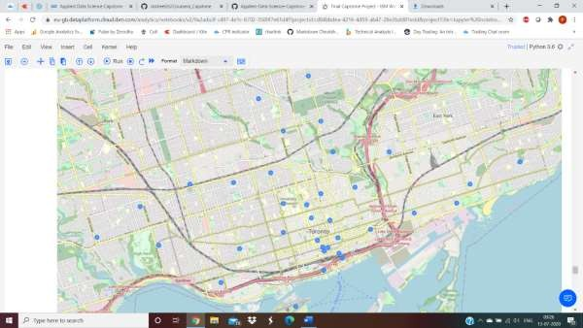
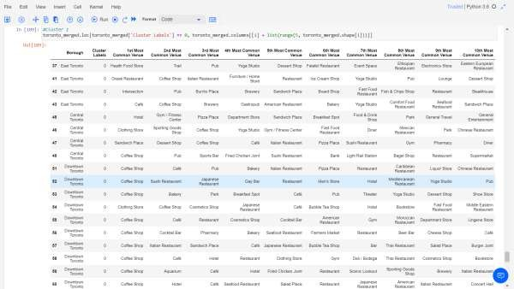
against the concerned borough. Then we explored the Manhattan neighbourhoods as venues and venue categories.
Vizualisatioin of Clusters:
Examining the Clusters

Slide 5
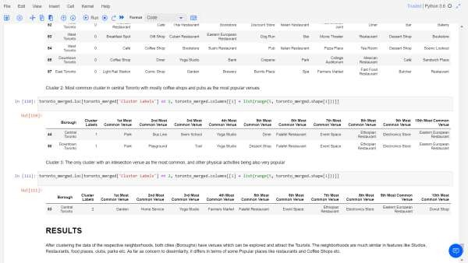
RESULTS
After clustering the data of the respective neighbourhoods, both cities (Boroughs) have venues which can be explored and attract the Tourists. The neighbourhoods are much similar in features like Studios, Restaurants, food places, clubs, parks etc. As far as a concern to dissimilarity, it differs in terms of some Popular places like restaurants and Coffee Shops etc.
Observations & Recommendations
When we compare the places, we observe that there are more Food places situated in Toronto Neighborhoods. Similarly, Gyms, Supermarkets, Restaurants and even more.
As far as a concern to recommendations, we recommend Toronto Neighborhoods will be considered first to visit. The tourists have easily travelling access due to Airport facility, which not only saves time but also to experience the heritage of Toronto. This will explore more, the attracting venues.
Conclusion
The Places of Toronto neighbourhoods have more like similar venues. As we know that every place is unique in its way, so that’s argument is present in both neighbourhoods. The dissimilarity exists in terms of some different venues and facilities but not on a larger extent.

